Slide 1
Pattern detection of Chikungunya patients in Bangladesh

Slide 2
What is Chikungunya?
Chikungunya is a virus that is transmitted from human to human mainly by infected Aedes albopictus and Aedes aegypti mosquitoes (later referred to as Aedes mosquitoes) acting as the disease-carrying vector.
Chikungunya causes sudden onset of high fever, severe joint pain, muscle pain and headache
As no vaccine or medication is currently available to prevent or cure the infection, control of Chikungunya involves vector control measures and encouraging people to avoid mosquito bites

Slide 3
Chikongunya & Bangladesh
Since May, Dhaka has seen 2,700 CHIKV cases, which prompted IEDCR(Institute of Epidemiology Disease Control & Research ) head, Professor Meerjady Sabrina Flora to say, “We’re currently facing a major outbreak of chikungunya”.
She said they are currently getting up to 100 calls from chikungunya patients or their relatives every day through a hotline they opened recently at their office in capital Dhaka.

Slide 4
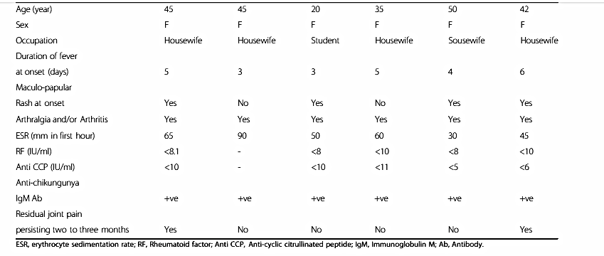
Published Documents

Slide 5
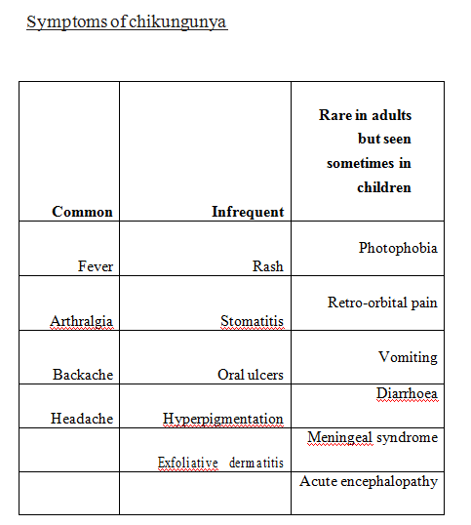
Symptoms
The symptoms will appear on average 4 to 7 days (but can range from 1 to 12 days) after being bitten by an infected Aedes mosquito

Slide 6
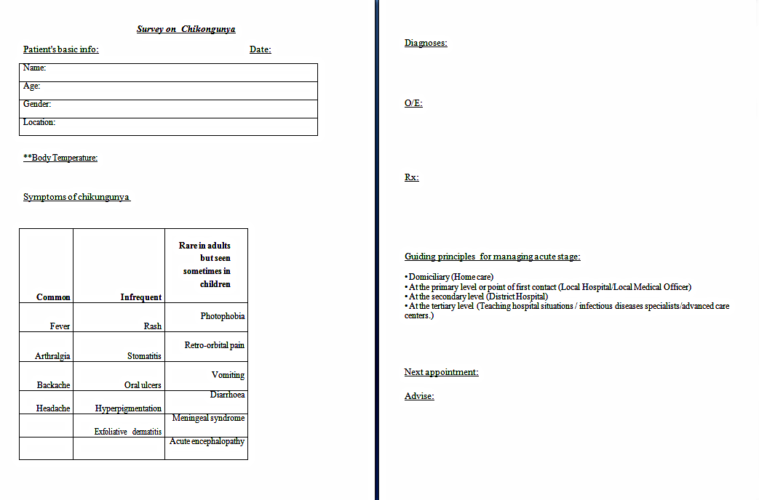
Data collection Form

Slide 7
Detection Methods
There are two methods to detect between dengue
and chikongunya.
Based on test (CBC, Dengue Ns1 )
Based on symptoms

Slide 8
Problem
It was easy to detect dengue based on symptoms but now for chikongunya, it is very tough to distinguish between chikongunya and dengue based on symptoms. Because of we are the people of 3rd world country, it is tough to detect chikongunya or dengue based on test because they are costly.

Slide 9
Our Goal
Detect the stage of chikongunya.
Give Advise based on stage.

Slide 10
Classification
Naive Bayes:
The Naive Bayes classifier is a simple supervised learning probabilistic classifier based on Bayes’theorem.

Slide 11
Pre-process
Data cleaning
Fill in missing values, smooth noisy data, identify or remove outliers, and resolve inconsistencies
Clustering
detect and remove outliers

Slide 12
Attributes There are fourteen important attributes used to compute the score:
Gender
Age
Location
Temperature
Fever
Arthralgia
Backache
Headache
Rash
Stomatitics
Oral ulcers
Vomiting
Diarrhoea
Joint Swelling

Slide 13
WORK IN WEKA

Slide 14
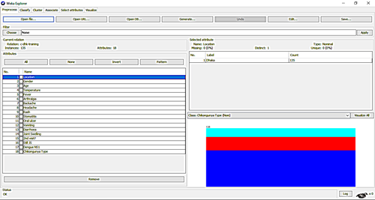
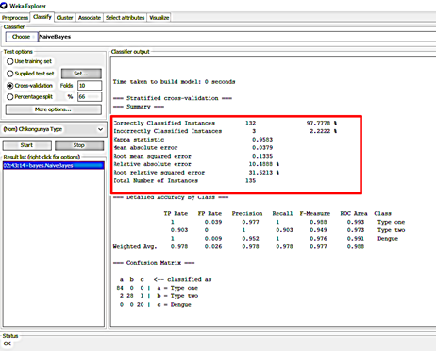
Training Set(Dhaka)

Slide 15
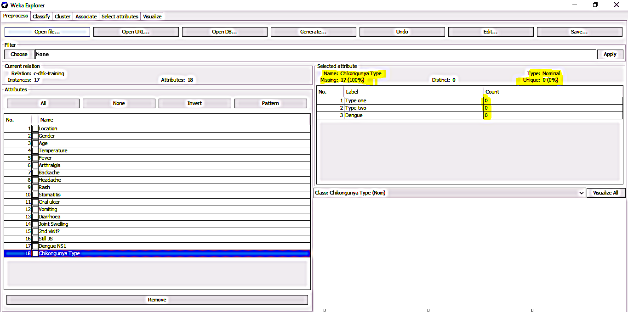
Test Set(Dhaka)

Slide 16
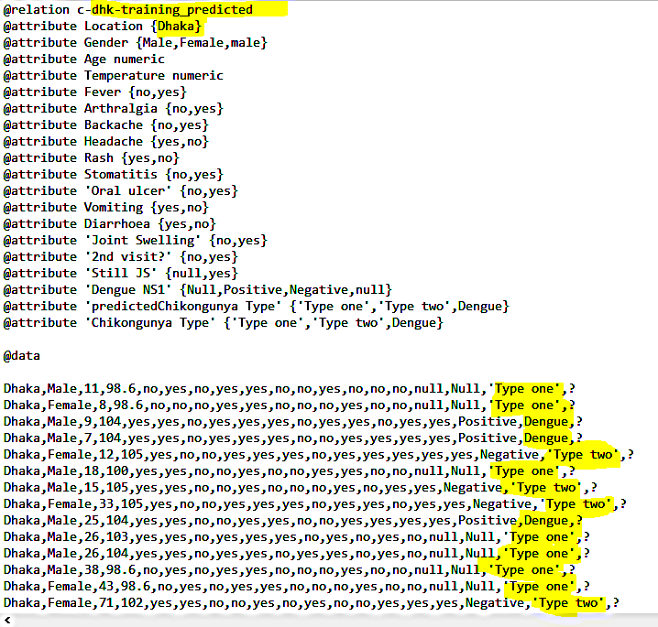
Predicted Result(Dhaka)

Slide 17
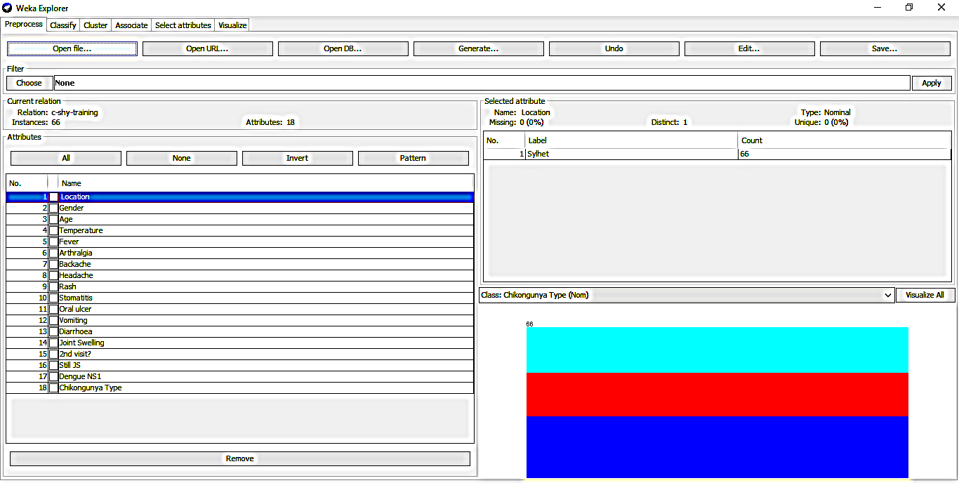
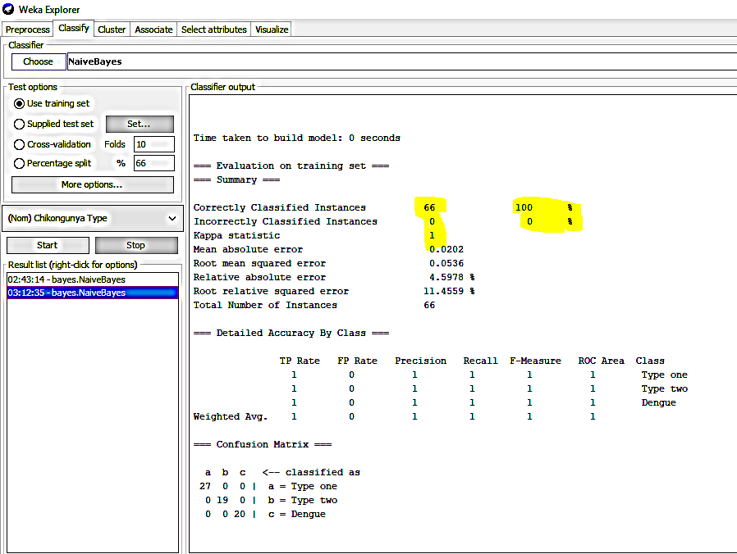
Training Set(Sylhet)

Slide 18
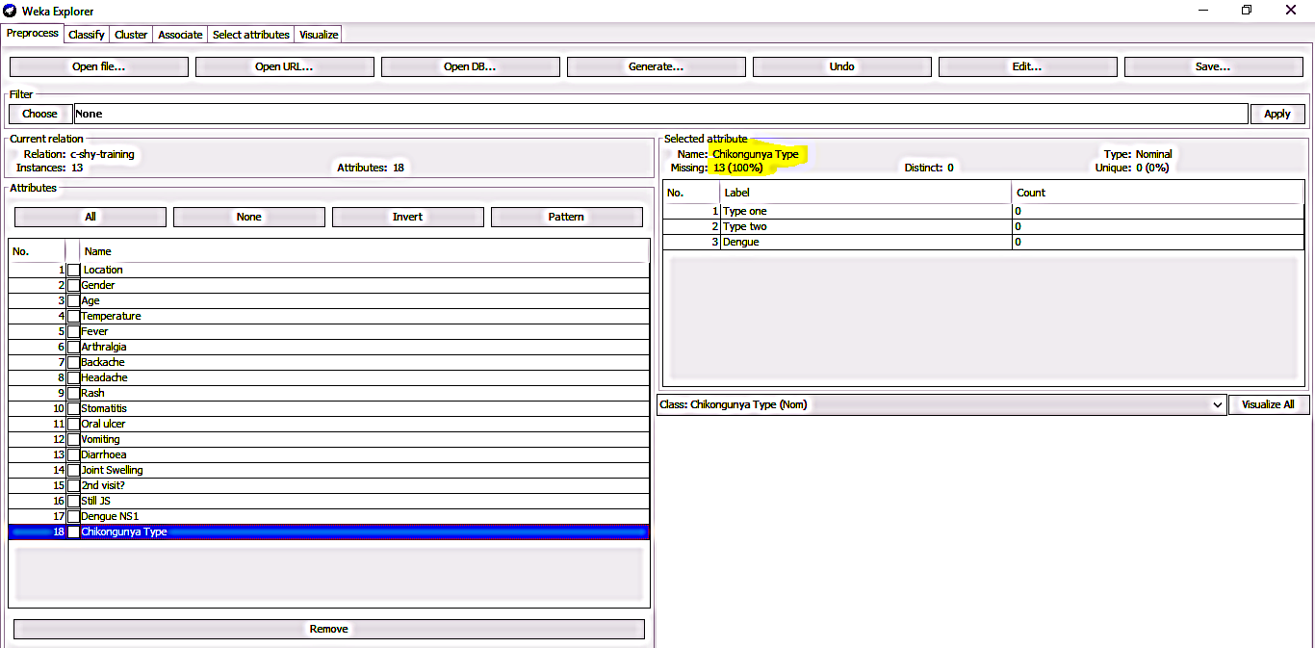
Test Set(Sylhet)

Slide 19
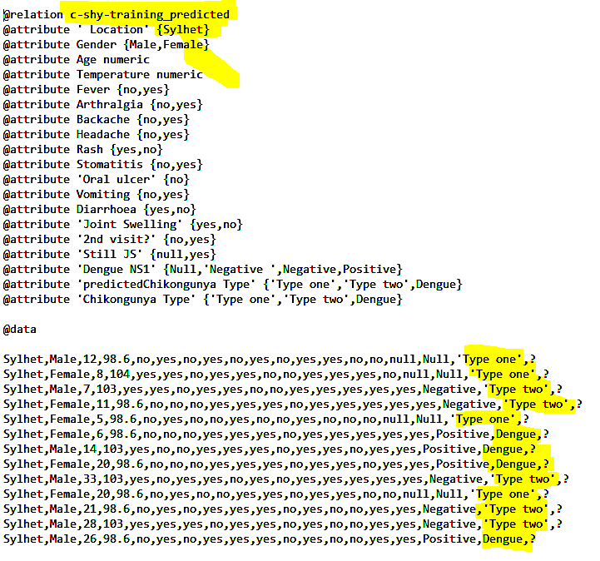
Predicted Result(Sylhet)

Slide 20
THANK YOU
☺ ☺ ☺ ☺

